Slide 1

Hepatitis E in Ireland
Dr Joanne O’Gorman & Niamh Murphy
Health Protection Surveillance Centre
ECDC Hepatitis E meeting, Stockholm, November 2018

Slide 2
Notifiable disease in Ireland
January 2016 – Universal blood donor screening for hepatitis E commenced in Ireland
15 December 2015 - Hepatitis E added to list of notifiable diseases
  All confirmed cases notifiable by clinicians and laboratories
  Notification data collated nationally by HPSC
Hepatitis E Case definition (only laboratory confirmed cases notifiable)
Acute case
At least one of the following two:
Hepatitis E virus IgM and IgG antibody positive
Detection of hepatitis E virus RNA
Chronic case
Hepatitis E virus RNA persisting for at least 3 months

Slide 3

Hepatitis E (HEV) notifications, 2016 and 2017
Total notifications = 90 in 2016, 54 in 2017
Blood donor screening by IBTS, n = 51 (35%)
  Median age of IBTS cases = 37 years (range: 18-66 )
  0.05% of male blood donors HEV positive compared to 0.03% females (no statistical diff)
Clinical cases, n = 93 (65%)
  Median age of clinical cases = 54 years (range: 15-84)
  58% clinical cases were male (no statistical diff)
  Higher clinical notification rate in males 50+
  Patient type known for 65% clinical cases – 37% hospital inpatients
Annual notification rate clinical cases:
  1.2/100,000 in 2016 (n=56)
  0.8/100,000 in 2017 (n=37)
% blood donors positive:
  0.04% in 2016
  0.03% in 2017

Slide 4
Number of clinical & IBTS HEV cases in Ireland,
Q1 2016 – Q3 2018
Notes:
90 cases in 2016, 54 cases in 2016, 53 cases in Q1-Q3 2018

Slide 5
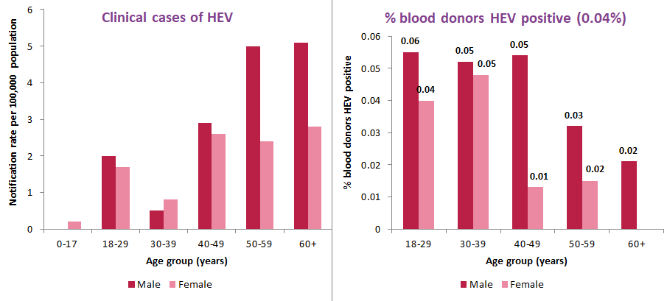
HEV notifications by age and sex in Ireland,
2016 and 2017
Notes:
Clinical cases – older males
IBTS cases – younger age groups

Slide 6
Enhanced surveillance - Hepatitis E
Enhanced surveillance of clinical cases introduced 1 July 2016 – 1 yr trial period
IBTS reported enhanced data for 18 month period (Jan 2016 - June 2017)
Departments of Public Health or IBTS interviewed cases
Clinical features, exposures and risk factors for severe disease
Enhanced data collection forms completed for 67 out of 120 cases (56%) notified Jan 2016 to end June 2017
Enhanced surveillance discontinued July 2017

Slide 7
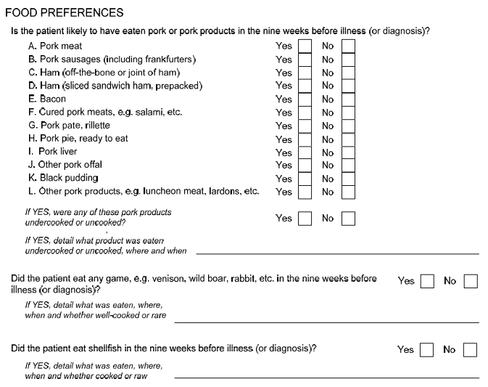
Food exposures section of ESF

Slide 8
% with each food exposures in the 9 weeks prior to illness/diagnosis (n=64)
Notes:
Cured pork: 8 clinical 36% compared to 31 IBTS 76%
Pork liver: 3 clinical 14% compared to 0 IBTS

Slide 9
% with each symptom
Symptoms | Clinical |  | IBTS |  | p-value
 | Num | % | Num | %
Any symptoms | 20 | 80.0 | 11 | 26.8 | <0.001
Fever | 9 | 39.1 | 2 | 4.9 | <0.001
Diarrhoea | 1 | 6.7 | 2 | 4.9 | 0.792
Abdominal pain | 6 | 26.1 | 4 | 9.8 | 0.084
Headaches | 5 | 22.7 | 0 | 0.0 | 0.001
Nausea | 9 | 39.1 | 2 | 4.9 | <0.001
Vomiting | 4 | 17.4 | 0 | 0.0 | 0.006
Joint pain | 10 | 45.5 | 0 | 0.0 | <0.001
Dark urine | 11 | 47.8 | 1 | 2.4 | <0.001
Jaundice | 12 | 50.0 | 1 | 2.4 | <0.001
Weakness of limbs/tingling | 6 | 27.3 | 0 | 0.0 | <0.001
Other neurological symptoms | 4 | 22.2 | 0 | 0.0 | 0.002
Other symptoms | 11 | 55.0 | 7 | 17.1 | 0.002

Slide 10
Discontinuation of enhanced surveillance – why?
Very consistent pattern of food consumption reported
Need case control study to determine if consumption of these food items differs between cases and the general population
Data collection creating additional workload for already over-burdened public health staff – worthwhile?
Revisit with more specific form guided by research into food chain?

Slide 11




FoVIRA
Foodborne Viruses in Ireland – farm to fork Investigation, Identifying Risk and mitigation Approaches for Hepatitis E Virus, Hepatitis A Virus, Norovirus & Sapovirus
To investigate the epidemiology of Hepatitis E Virus in Irish pigs and the occurrence of Hepatitis E Virus in Irish pigmeat products .
To determine the occurrence of Hepatitis E Virus, Hepatitis A Virus Norovirus and Sapovirus, in Irish oysters and berries.
To genetically characterise Hepatitis E Virus, Hepatitis A Virus, Norovirus and Sapovirus isolates and to determine the phylogenetic relationship between isolates detected in Irish pigs, shellfish, berries and those from human clinical samples.
To conduct an exposure assessment of the risk posed to consumers by Hepatitis E Virus, Hepatitis A Virus, Norovirus & Sapovirus in the food chain and to identify appropriate risk mitigation measures
Research Funding: Department of Agriculture Food and the Marine Institutional Research Measure 15F724

Slide 12
The Irish experience
Impact of universal blood donor screening & change in laboratory testing practice on surveillance data
Increased clinical awareness of HEV in recent years
Notification includes a case definition for chronic infection but not frequently utilised
Molecular epidemiology: Genotype 3 – predominantly 3c
Enhanced surveillance pilot useful but limited national food consumption data & no case control studies
Focus on risk in the food chain – FoVIRA study

Slide 13
Acknowledgements
HPSC
  Lelia Thornton
  Patricia Garvey
NVRL
  Charlene Benett
  Cillian DeGascun
  Suzie Coughlan
  Jonathan Dean
  Allison Waters
  Linda Dunford
IBTS
  Fiona Boland
  Niamh O’Flaherty
CVRL
  Conor Davin
  Louise Britton
  Eoin Ryan
Marine Institute
  Sinead Keaveney
  Amy Fitzpatrick

